Slide 1
WELCOME
OBSERVATIONS of Hazardous audit committee installation at Ammonia storage,Chlorination Section,Acid tanks and Gas storage areas
Visit No-2.

Slide 2
Ammonia storage section
Steps involved in the audit
Verification of inspection report of all pressure tanks of refrigeration system; found normal.
Instrumentation Bypass logics of all equipments checked found normal.
Safety accessories, availability and status checked found normal.
Wind Socks at 03 different locations as per HAZOP recommendation found in intact condition.

Slide 3
Ammonia gas Detectors at two different locations checked and verified.
Chlorination installation and chlorine scrubber of ammonia CT section has been checked thoroughly and Loopholes are identified.
Through field inspections and identifications of hazards and loopholes along with the status of previous audit report its compliance and new points are shown in the following slides with pictorial views.

Slide 4
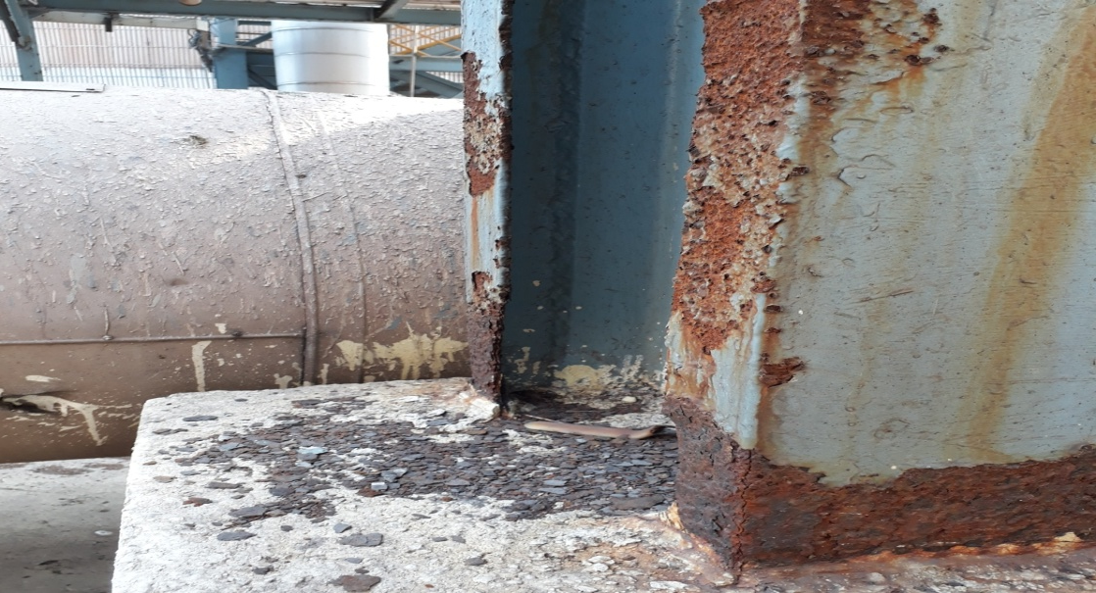
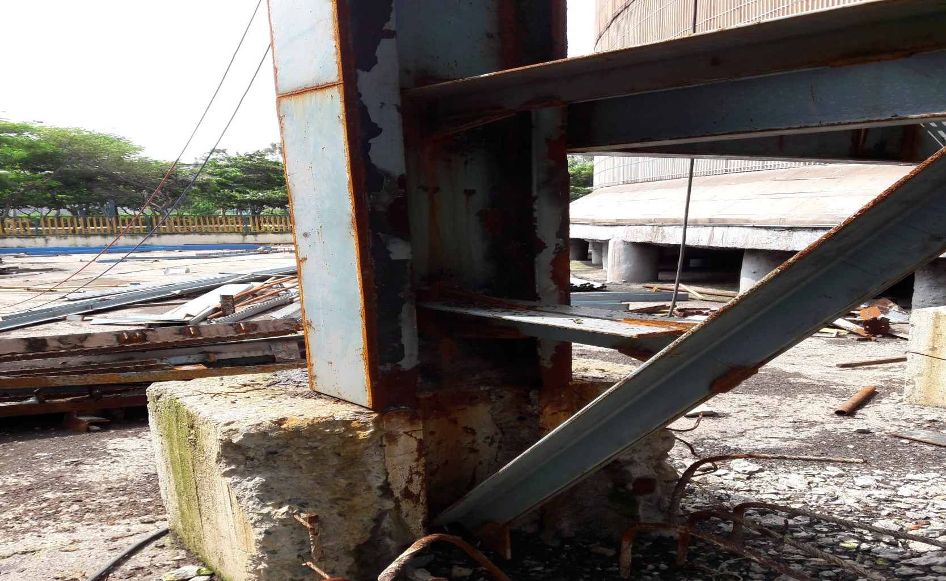
Pipeline support structures of Ammonia Tank-B
Then, Condition of the foot base of vertical column at Tank-B.
Now, the corroded Column Base is corrected and proper strengthening done.

Slide 5
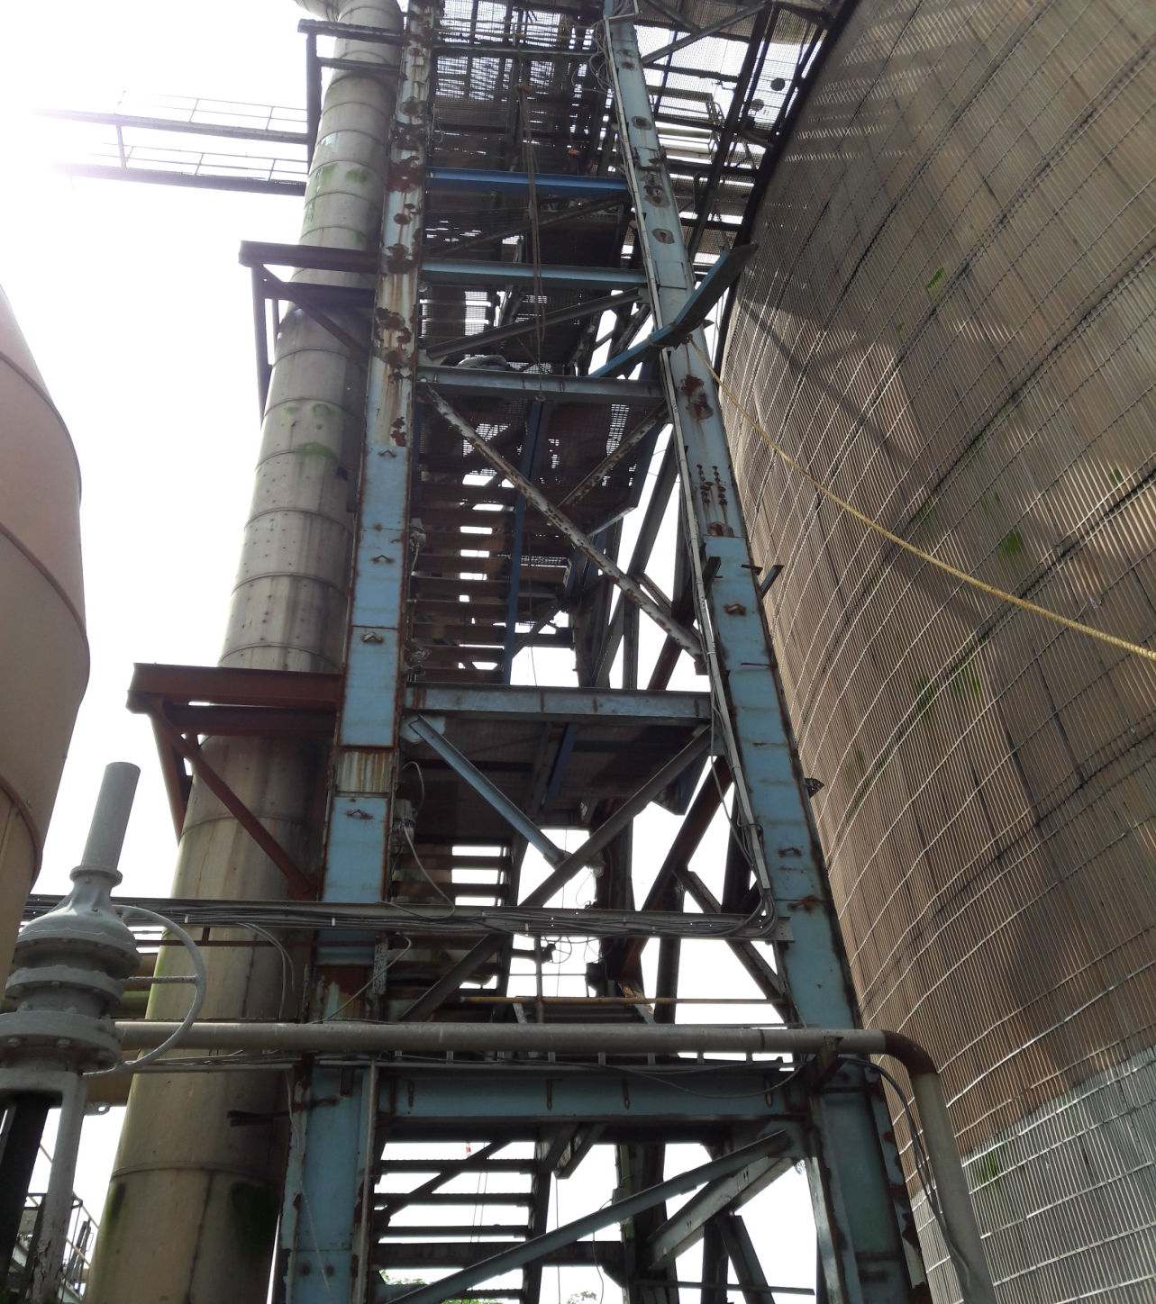
Ammonia Tank-B
Then, Condition of the Columns
Now,Strengthening Job is under Progress, Column is enforced with new plates

Slide 6
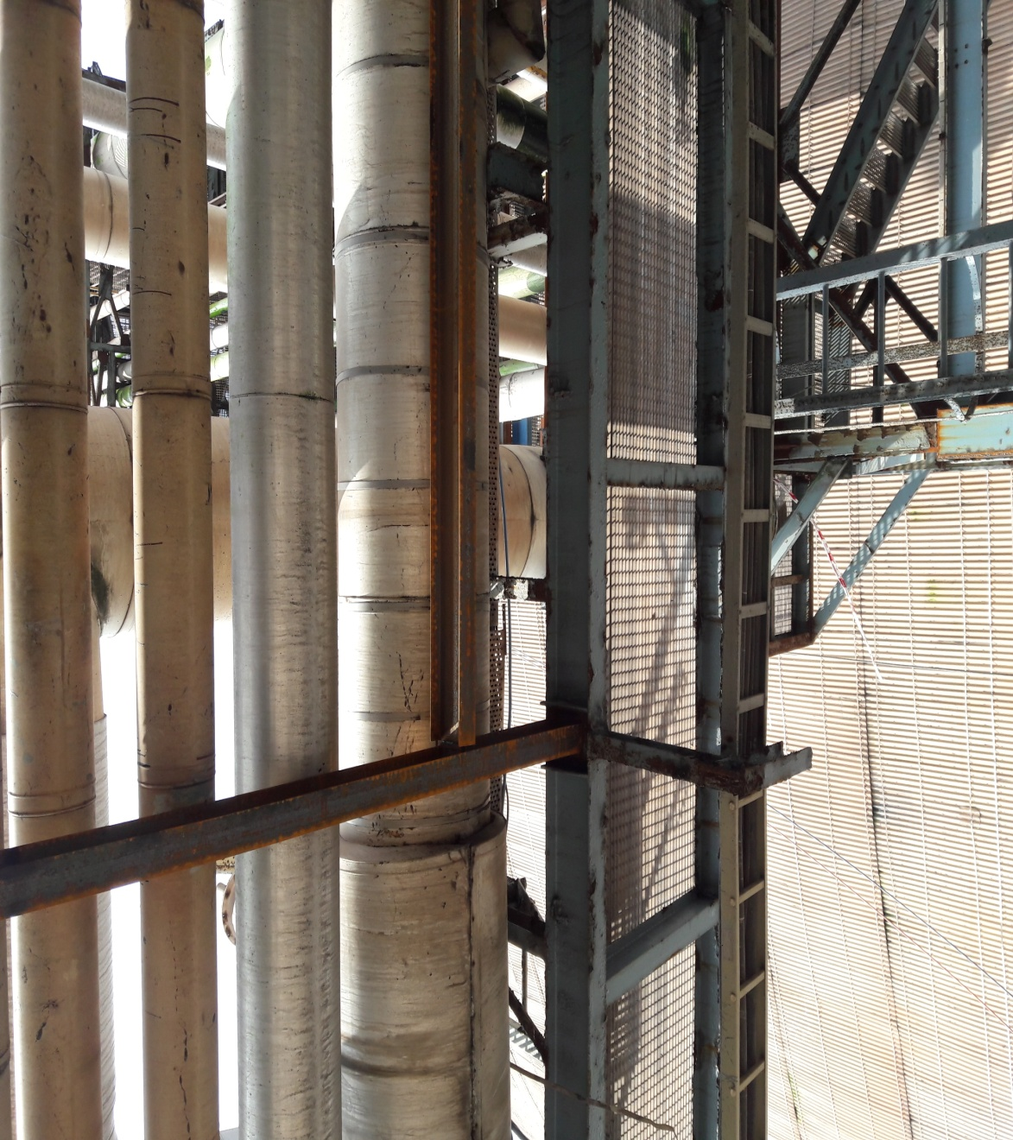
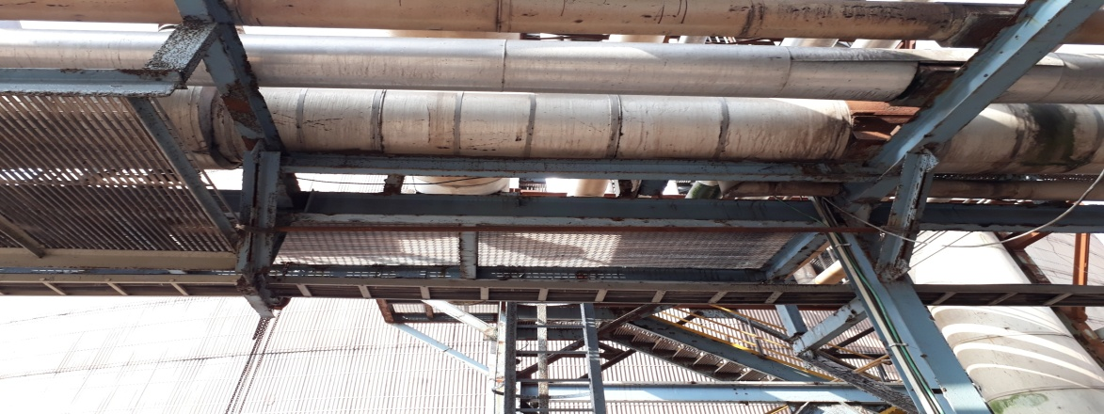
Now, new support beam installed
Then, corroded support beam in pipe rack near tank-B
Pipe Rack at Ammonia Tank-B

Slide 7
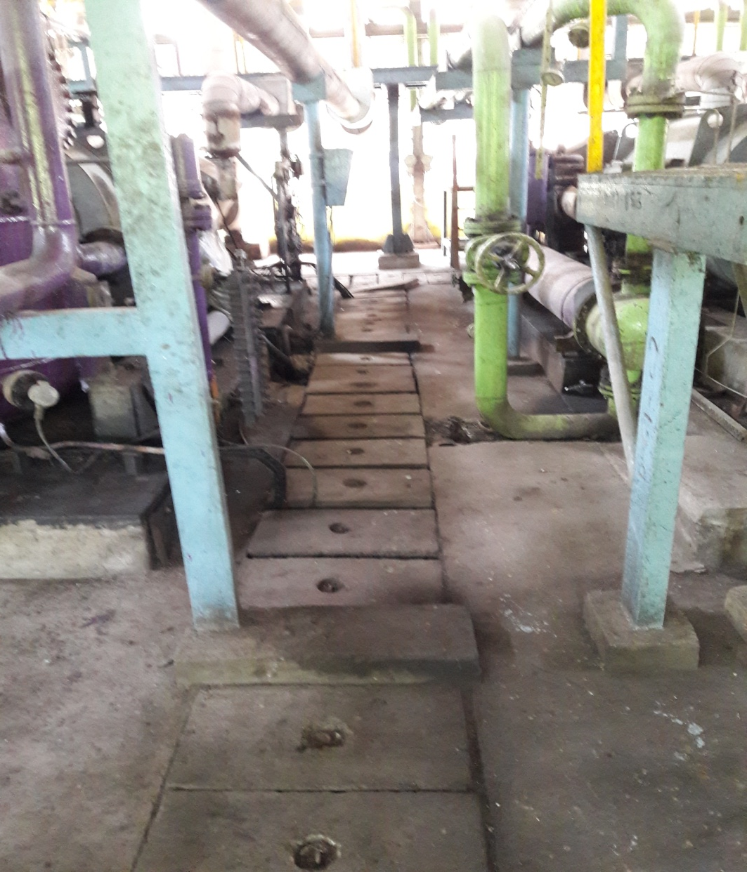
Compressor House
Then, condition of the slabs in compressor house was in disorganized condition
Now, the slabs are in organized condition

Slide 8
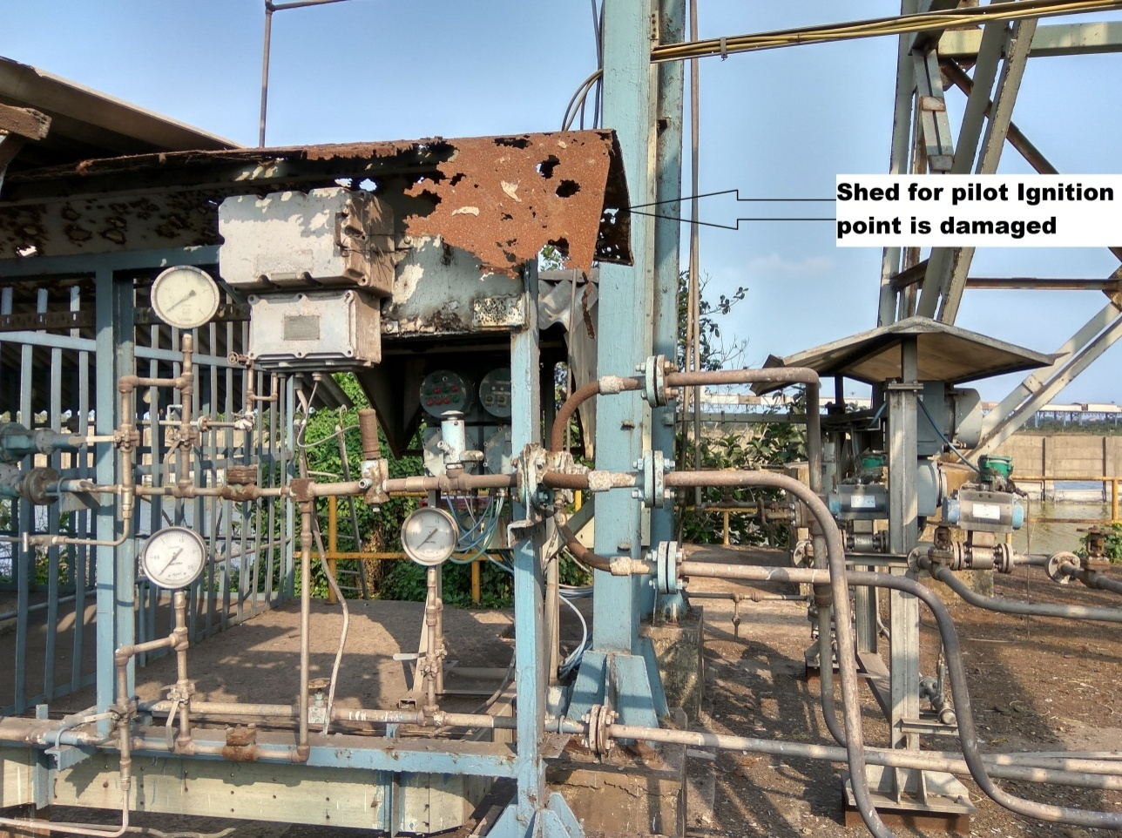
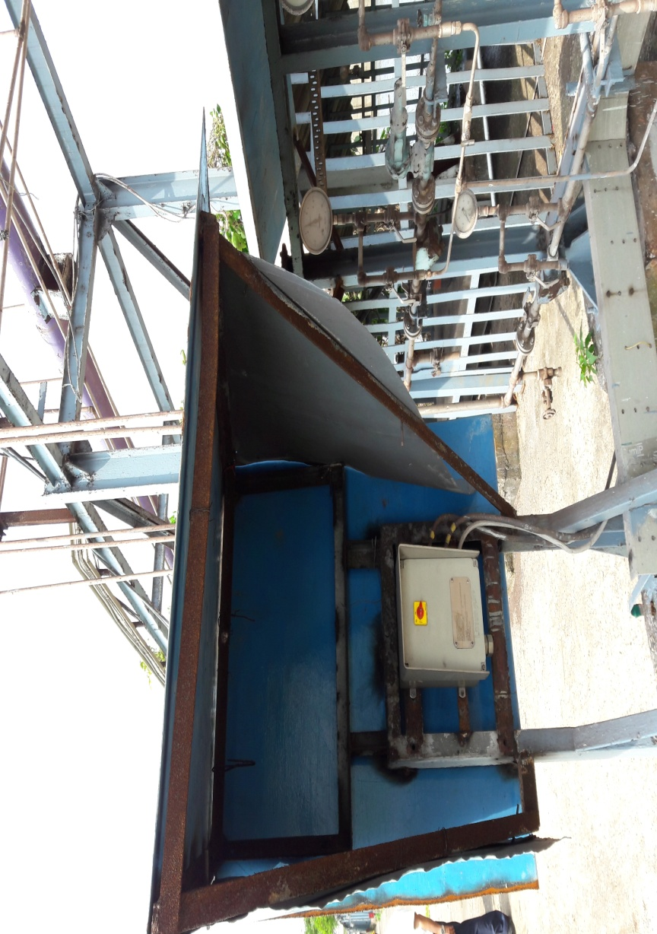
Shed for pilot ignition Corrected

Slide 9
New Points Marked at Ammonia Storage area
Shoe support for 30 “ Vapor ammonia line in TANK-C is dislocated. The same is to be fixed

Slide 10
Support Channel of Walkway Path is highly Corroded and requires
Replacement in Ammonia Tank-C

Slide 11
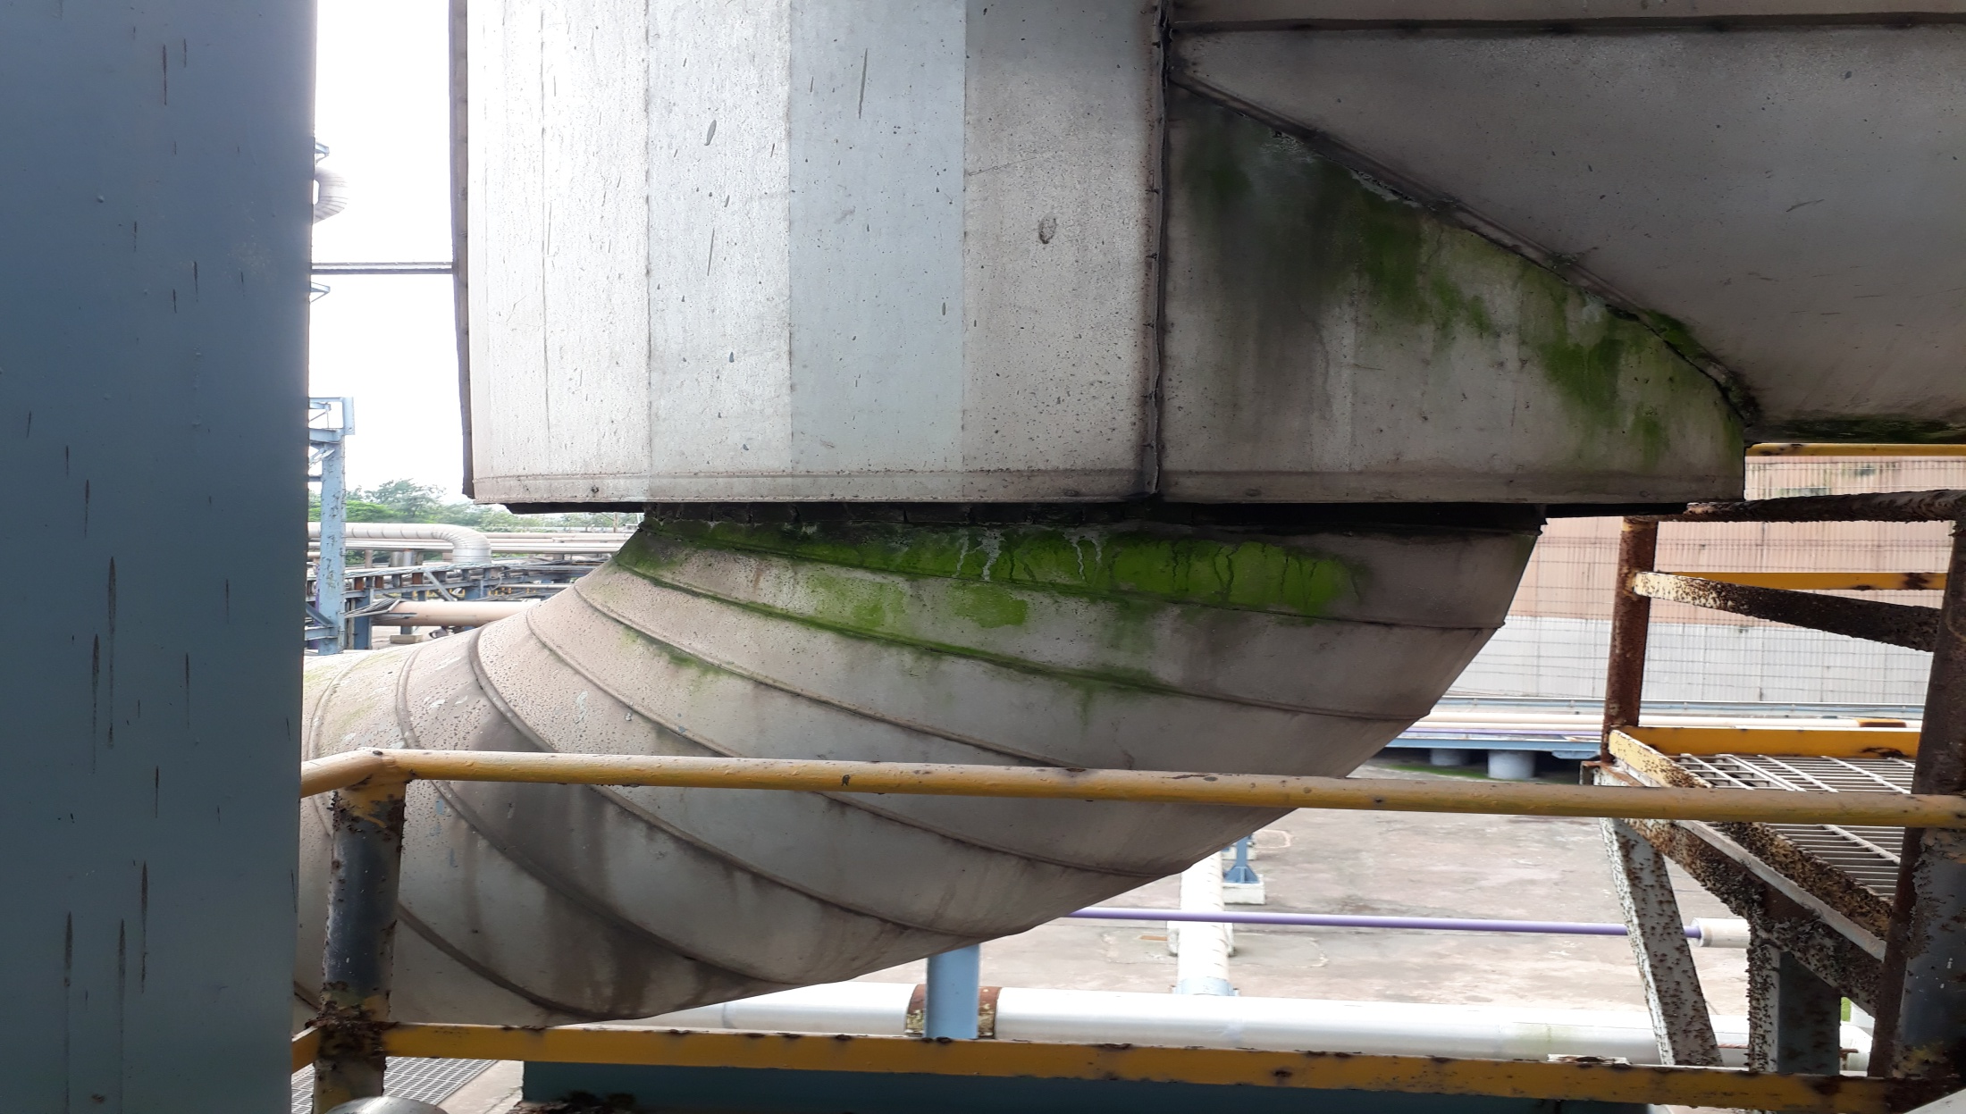
Algae contamination in the insulation line is observed, replacement of insulation is required

Slide 12
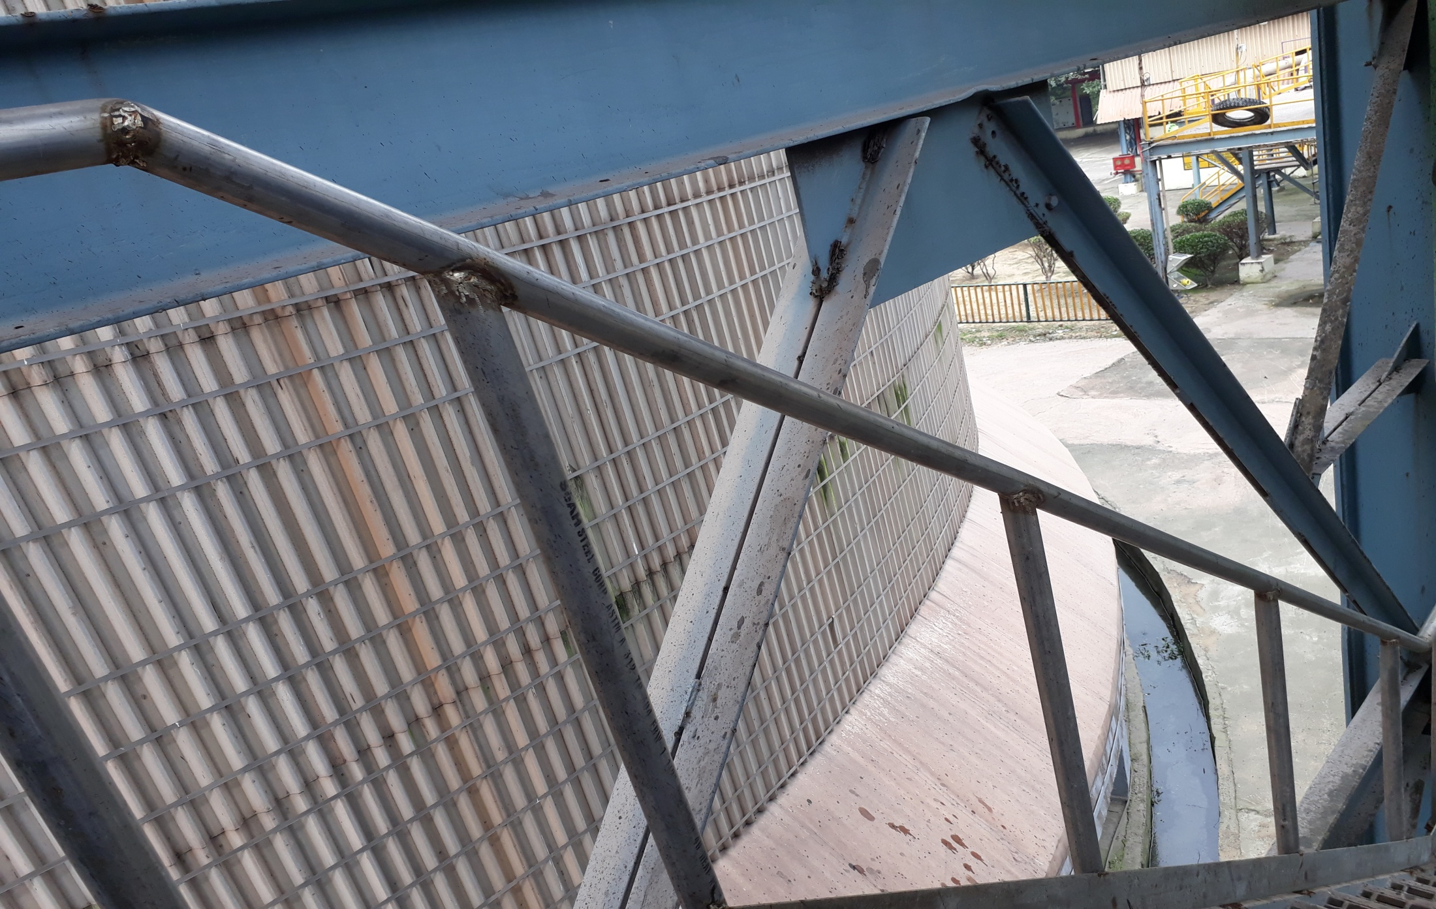
One strip is missing in the staircase of Ammonia Tank-C

Slide 13
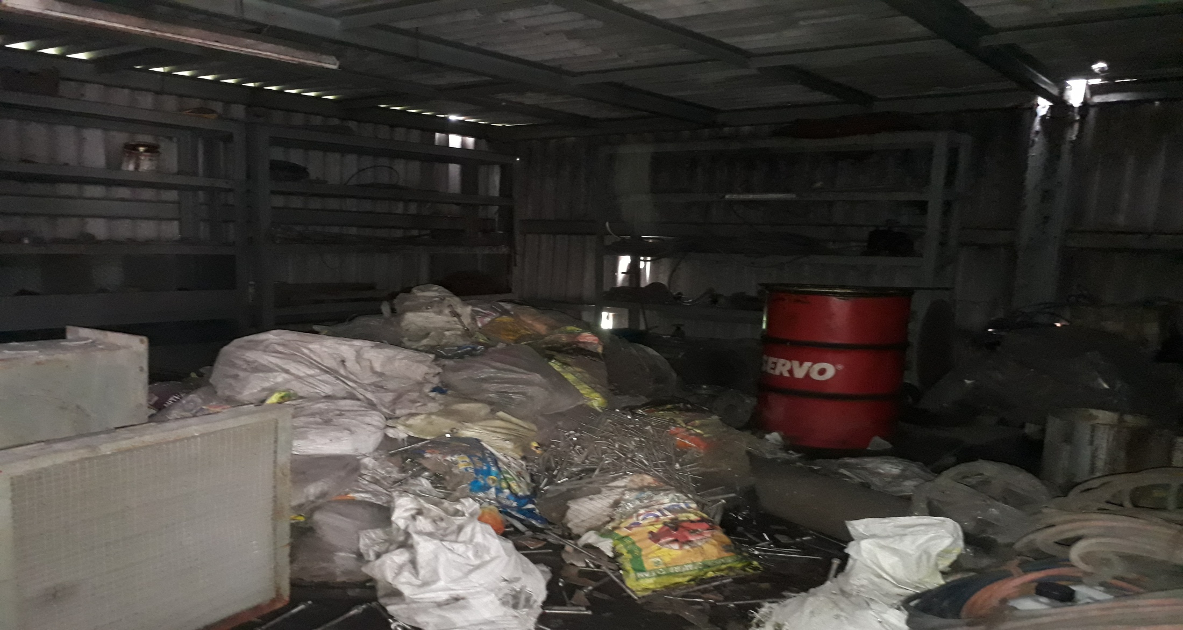
Materials in the mechanical store room is found in disorganized manner at Ammonia Storage

Slide 14
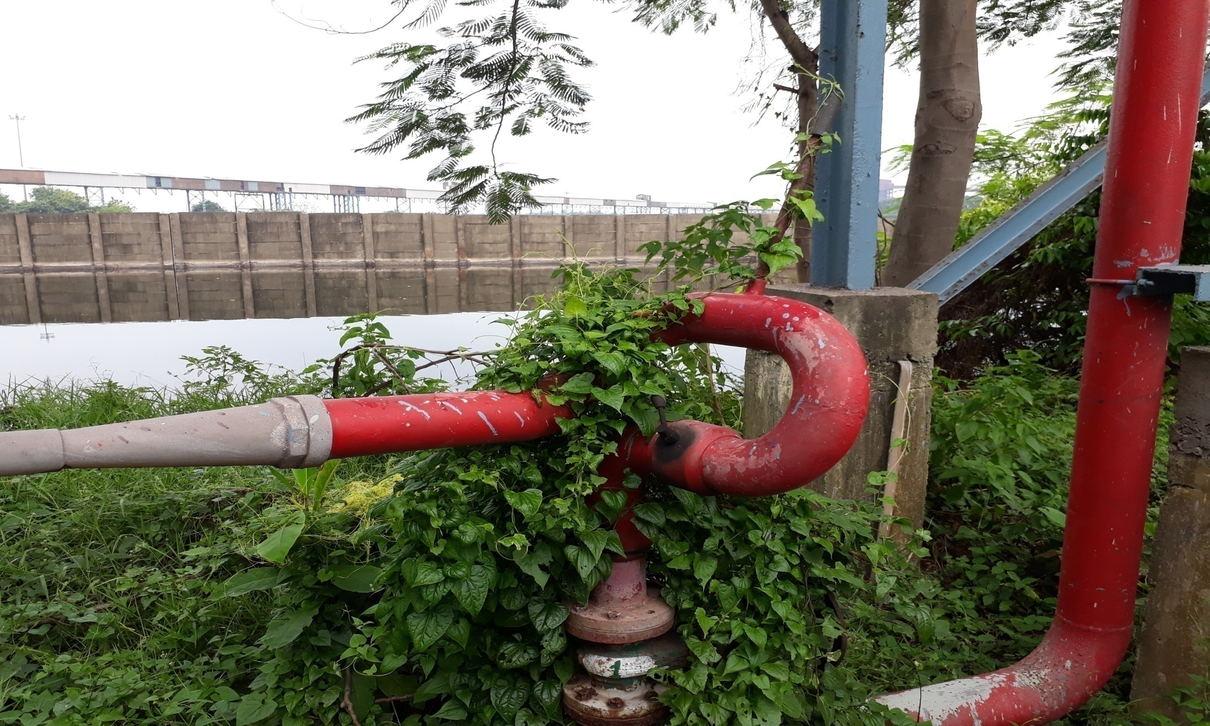
Vegetation is to cleared around the pipelines

Slide 15
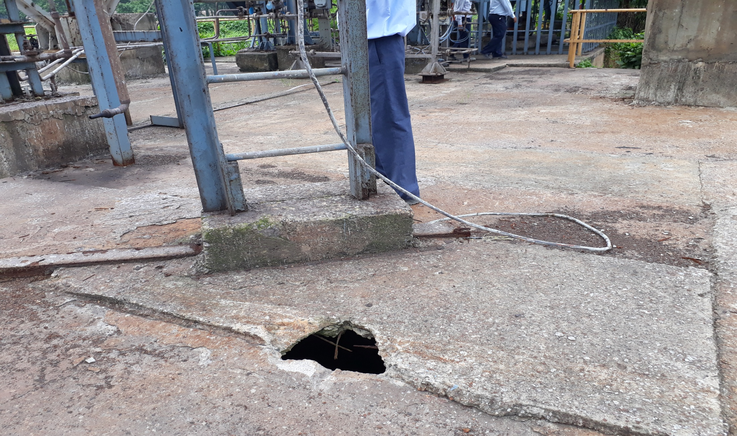
Concrete slab is damaged at the base floor of Ammonia flare stack

Slide 16
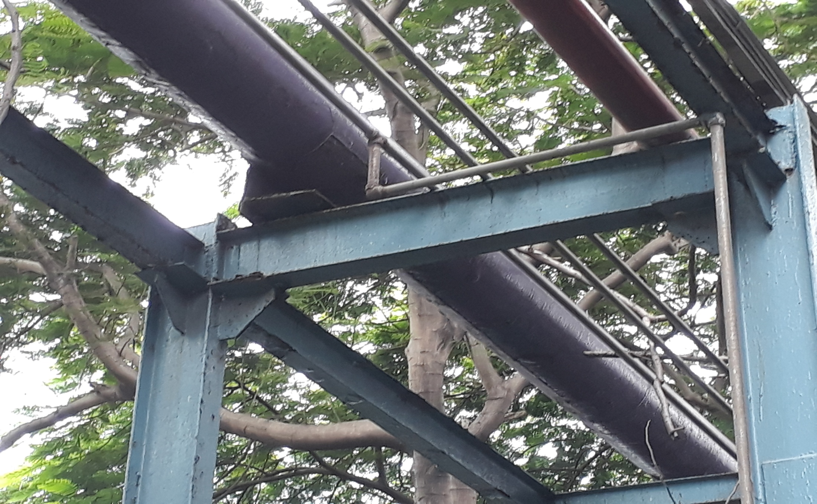
Proper support missing in the vent line at ammonia Storage section.

Slide 17
Chlorination installation at Ammonia Storage
MSDS board installation is required.
Do’s and don’t board is to be installed.
Safety precaution board is required.
Wind Sock in the vicinity area is to be installed.
Chlorine scrubber system is not working due to leakage in the caustic lye solution storage tank, the same is to be corrected.

Slide 18
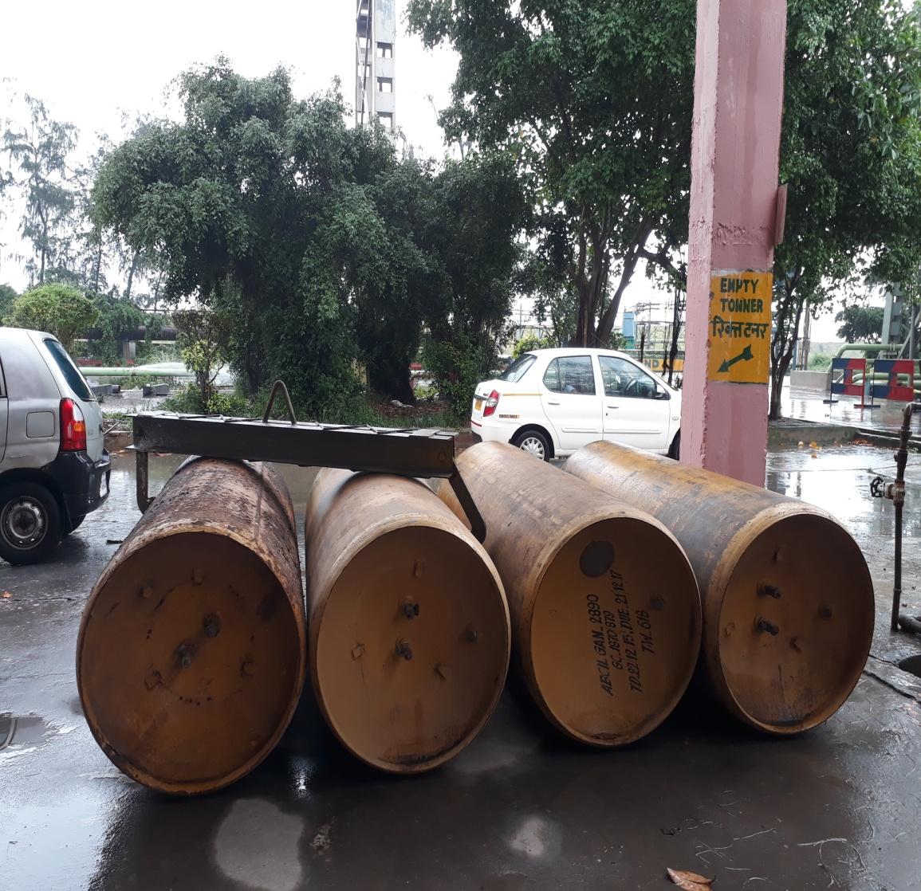
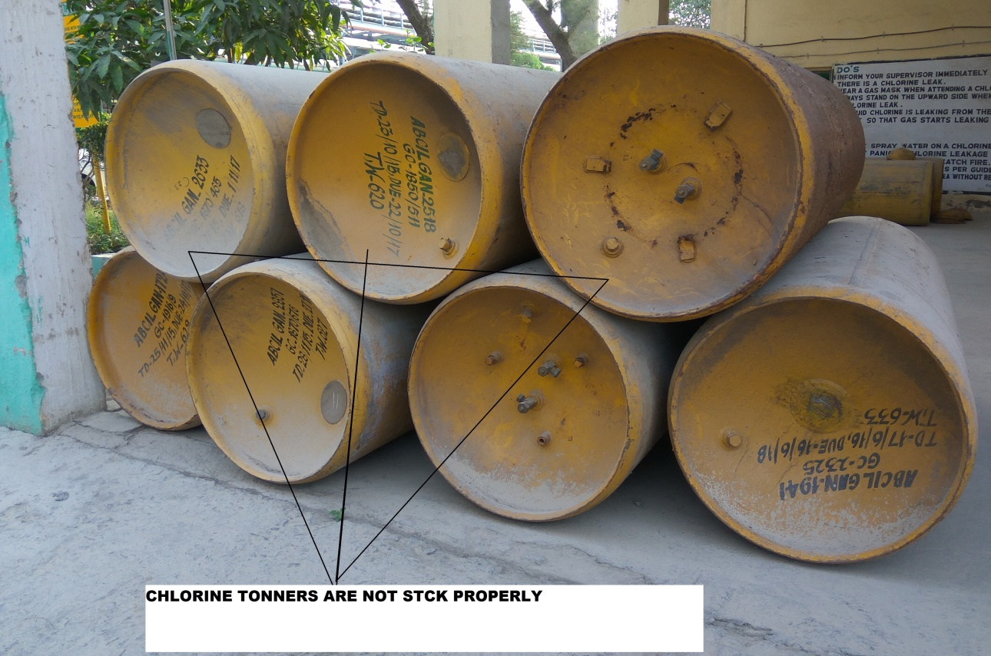
Chlorine installation at Raw Water treatment Plant
Now, The Ton Cylinders found stacked as per IS standard.
Then, the ton cylinders were not stacked as per IS standard.

Slide 19
Chlorination system at TG Cooling Tower.
MSDS board installation is required.
Hose arrangement at the vicinity of chlorination house is required.
Do’s and Don’t board in both hindi and oriya language should be installed.

Slide 20
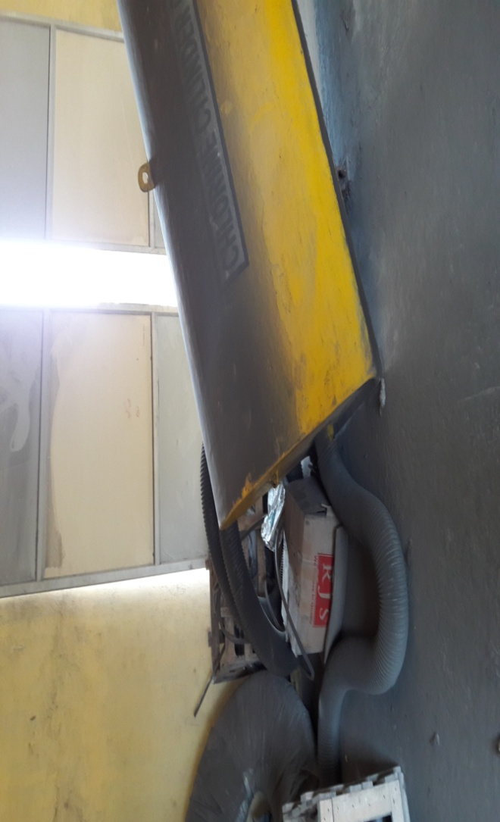
Chlorine scrubber not placed properly and unwanted materials found in the chlorine house at TG cooling tower.

Slide 21
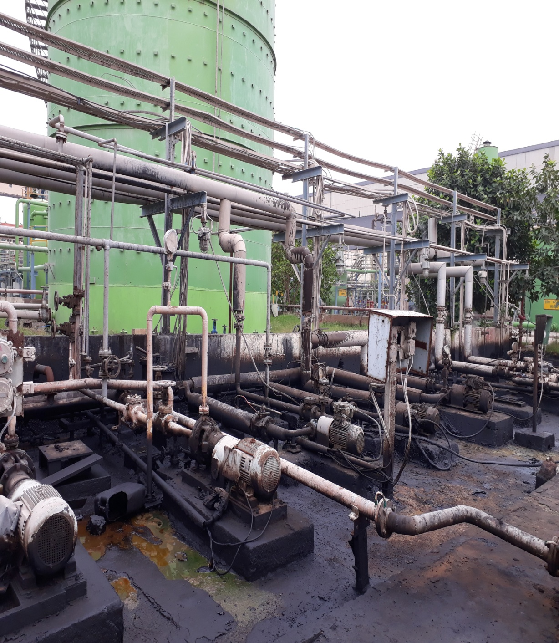
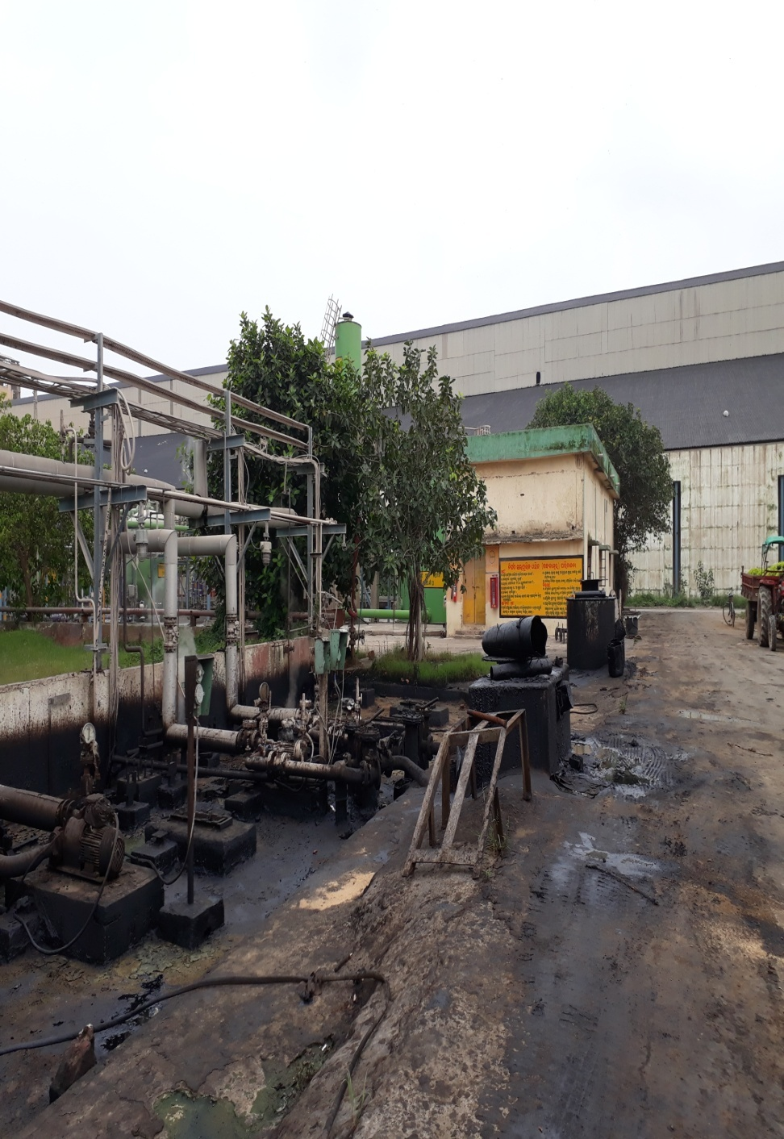
Proper Cleaning is required at pumping and roadways at FO tank area

Slide 22
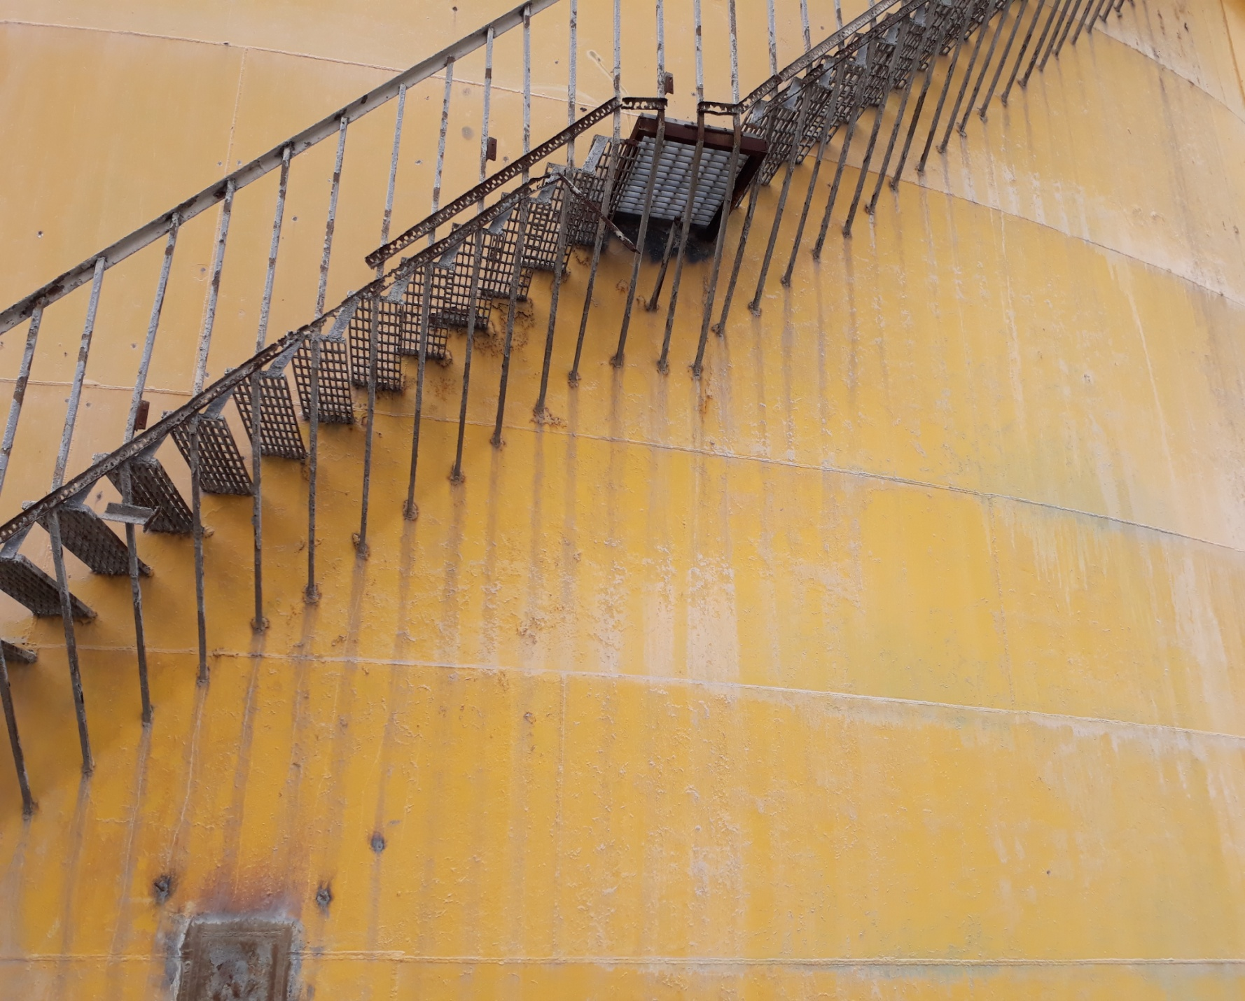
Staircase of Sulphuric Acid is badly corroded

Slide 23
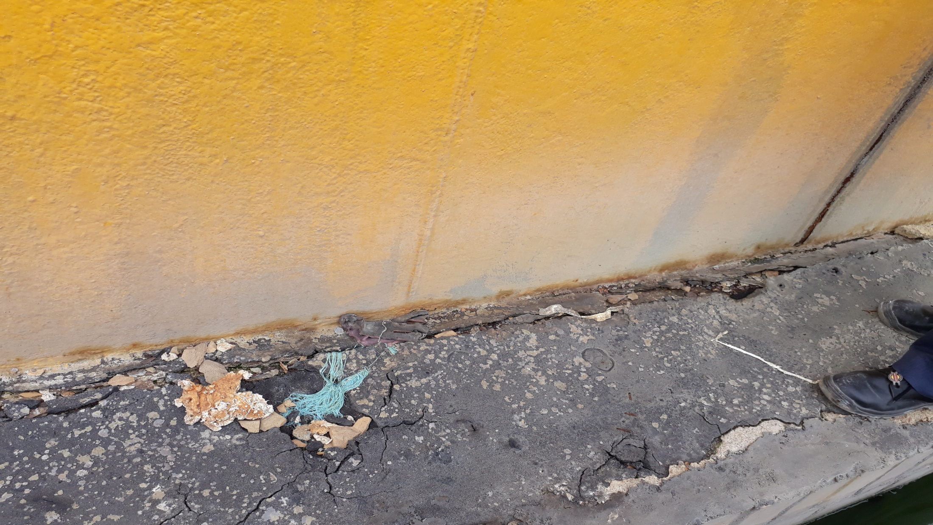
Base plate of sulphuric Acid Tank is corroded, proper action is required

Slide 24
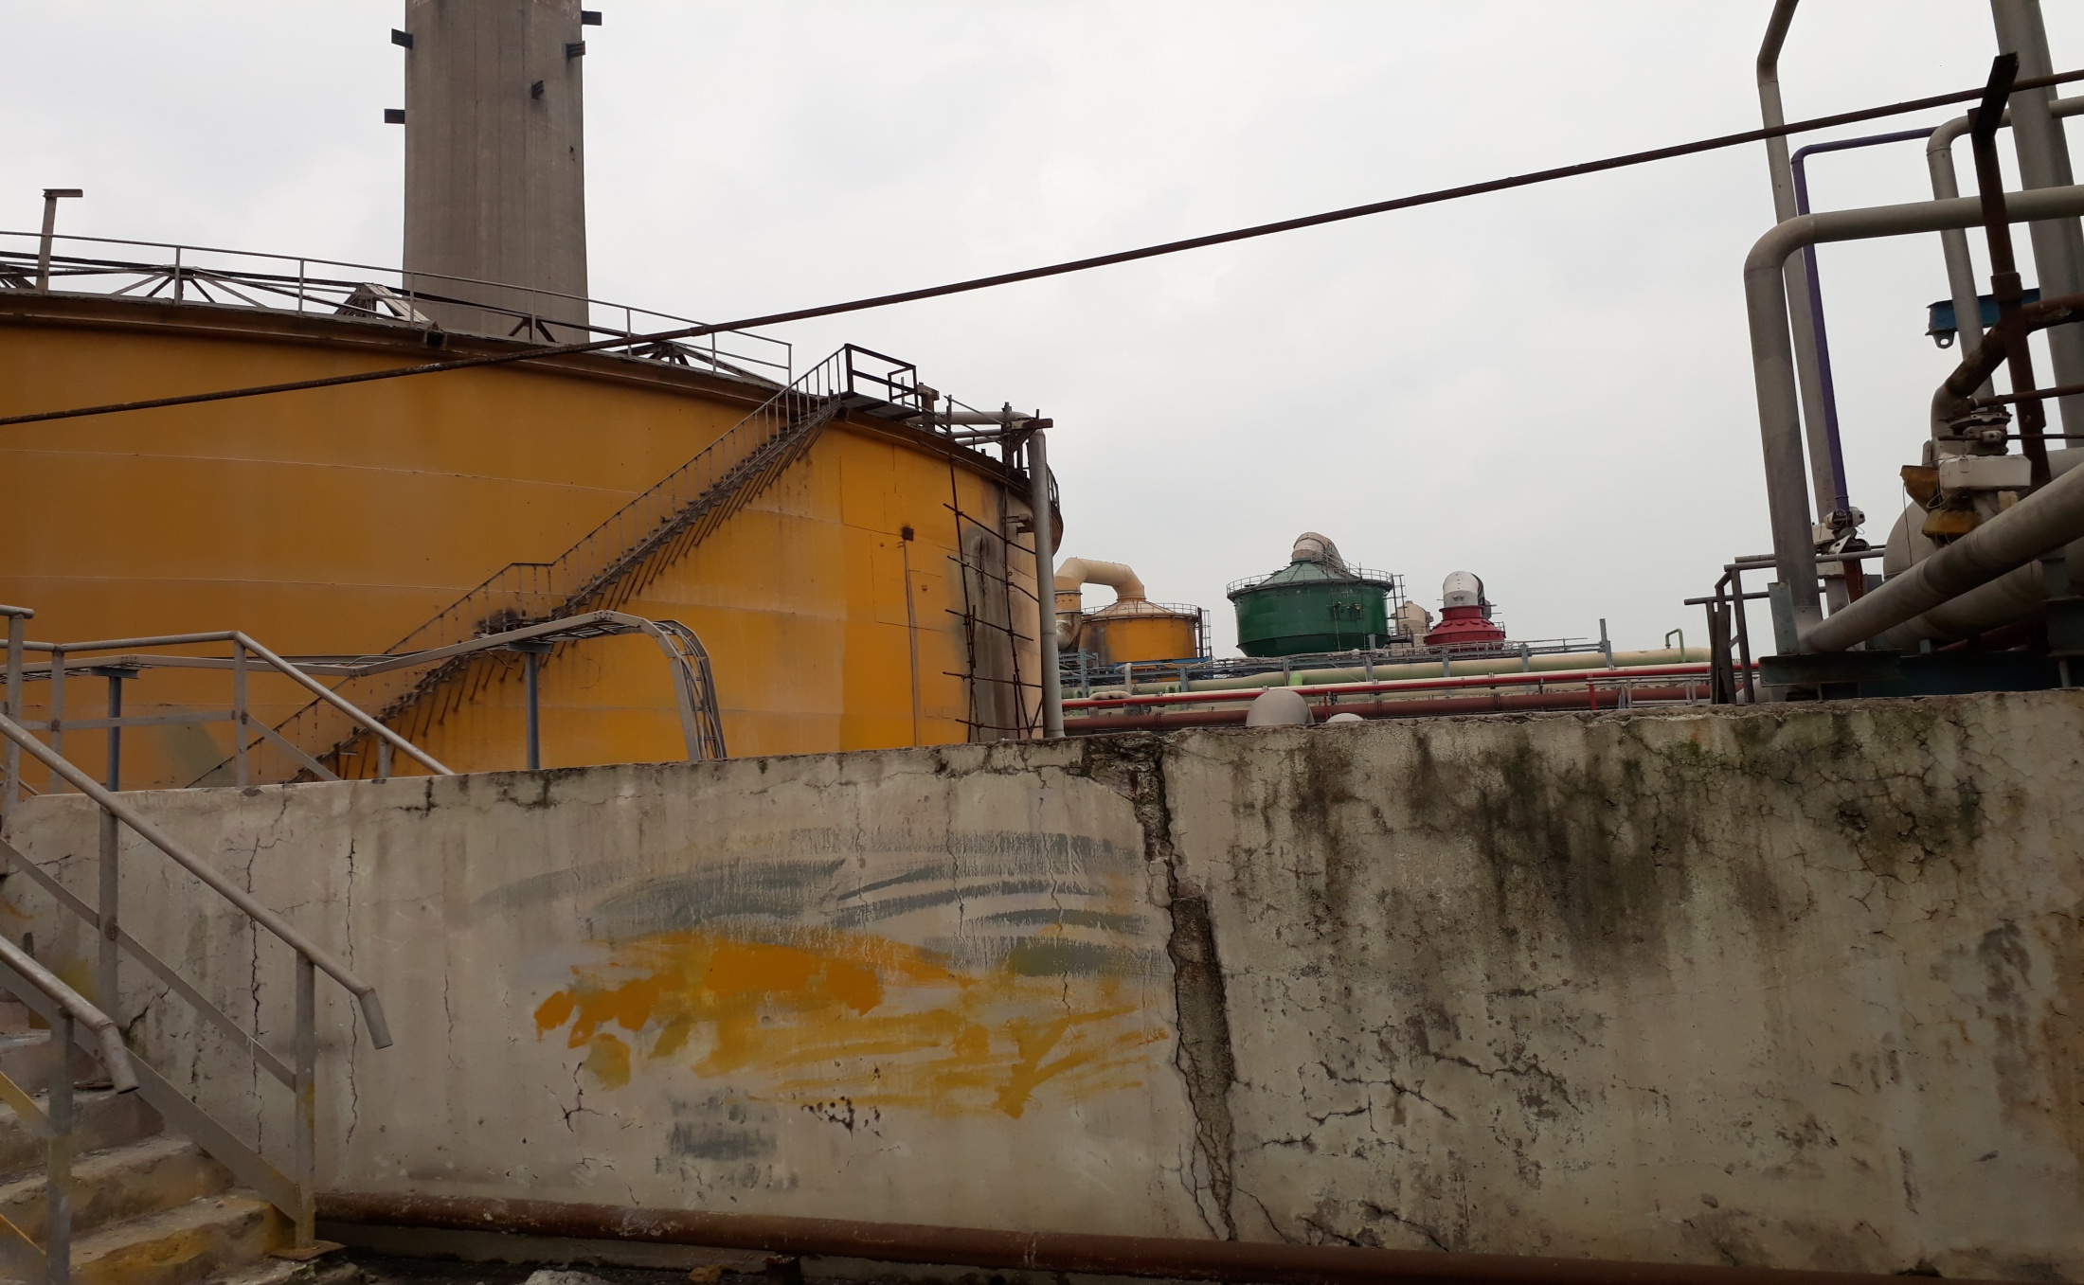
Dyke Wall of Sulphuric Acid tank requires repairmen

Slide 25
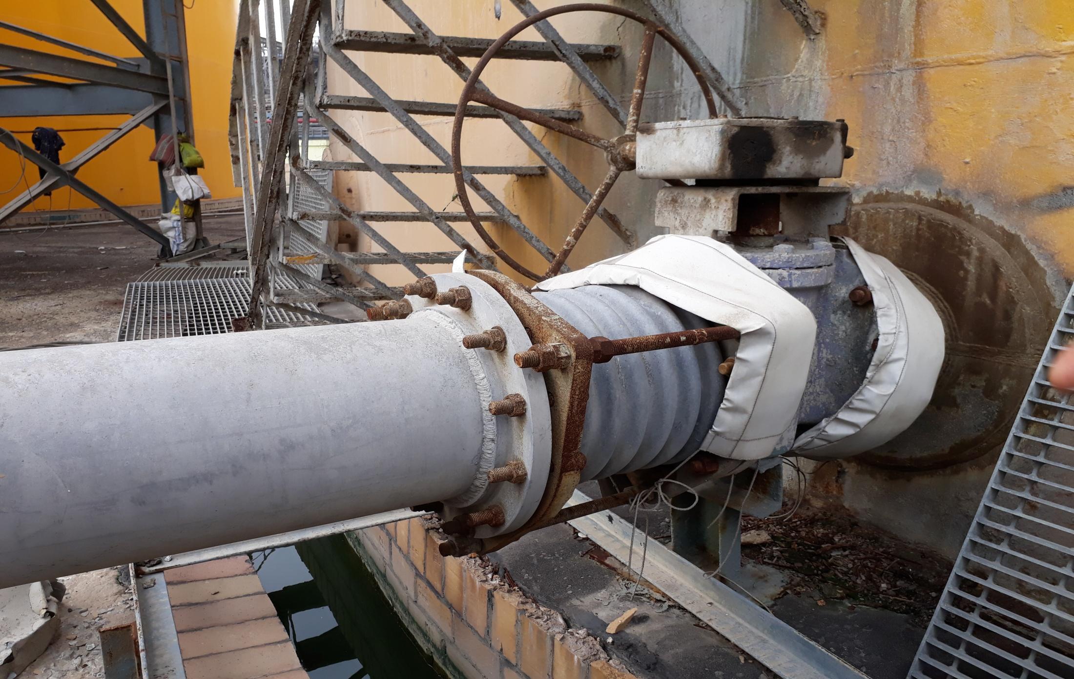
Bolt of the bellow flange is highly corroded at sulphuric
Acid tank

Slide 26
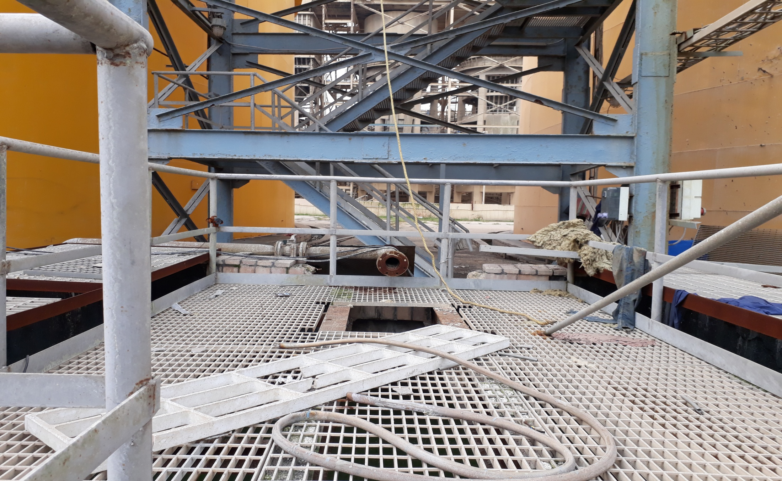
Effluent/Drain Acid pumping arrangement at sulphuric Acid Tank Area is missing

Slide 27
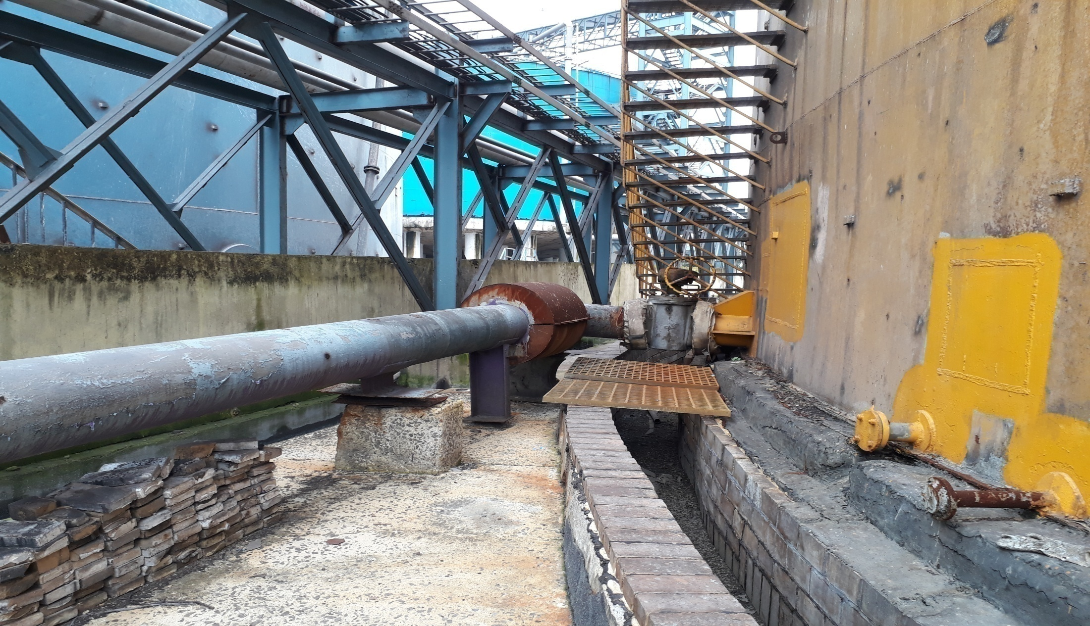
Pipeline Support at sulphuric Acid export tank is improper

Slide 28
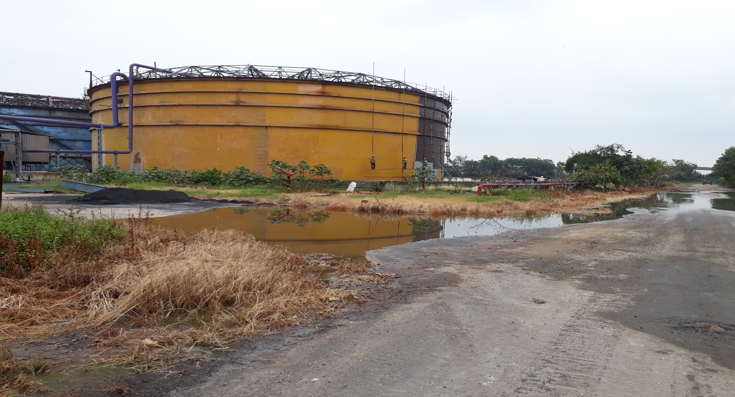
Vegetation growth observed at the periphery of Dyke wall at sulphuric acid export tank

Slide 29
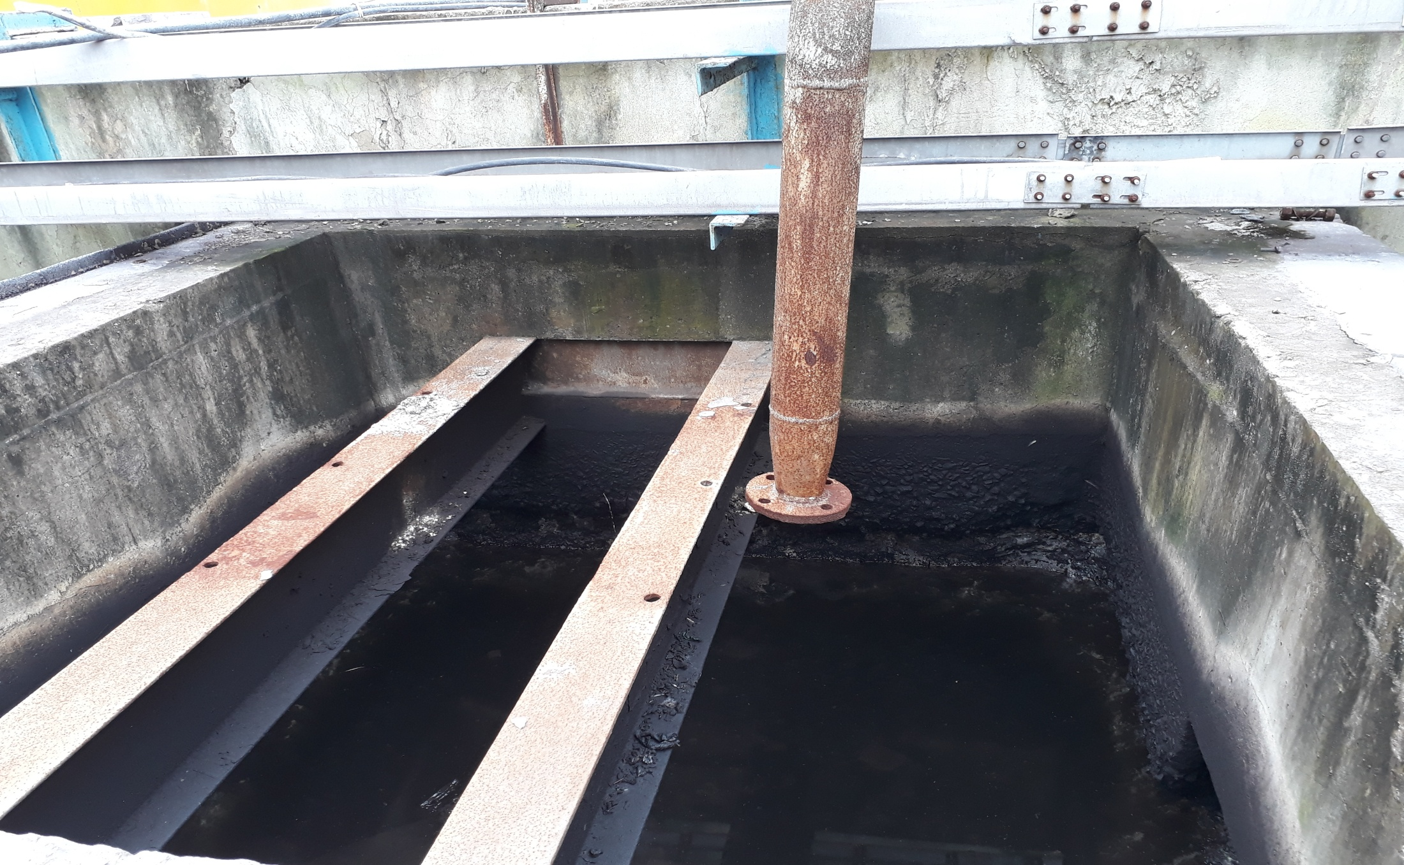
Effluent/Drain Acid pumping arrangement is missing at Sulphuric Acid Export Tank

Slide 30
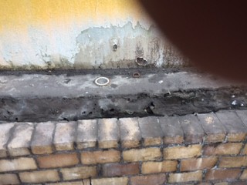
Tank Pitting and nearby wetness observed in sulphuric Acid Tank-A

Slide 31
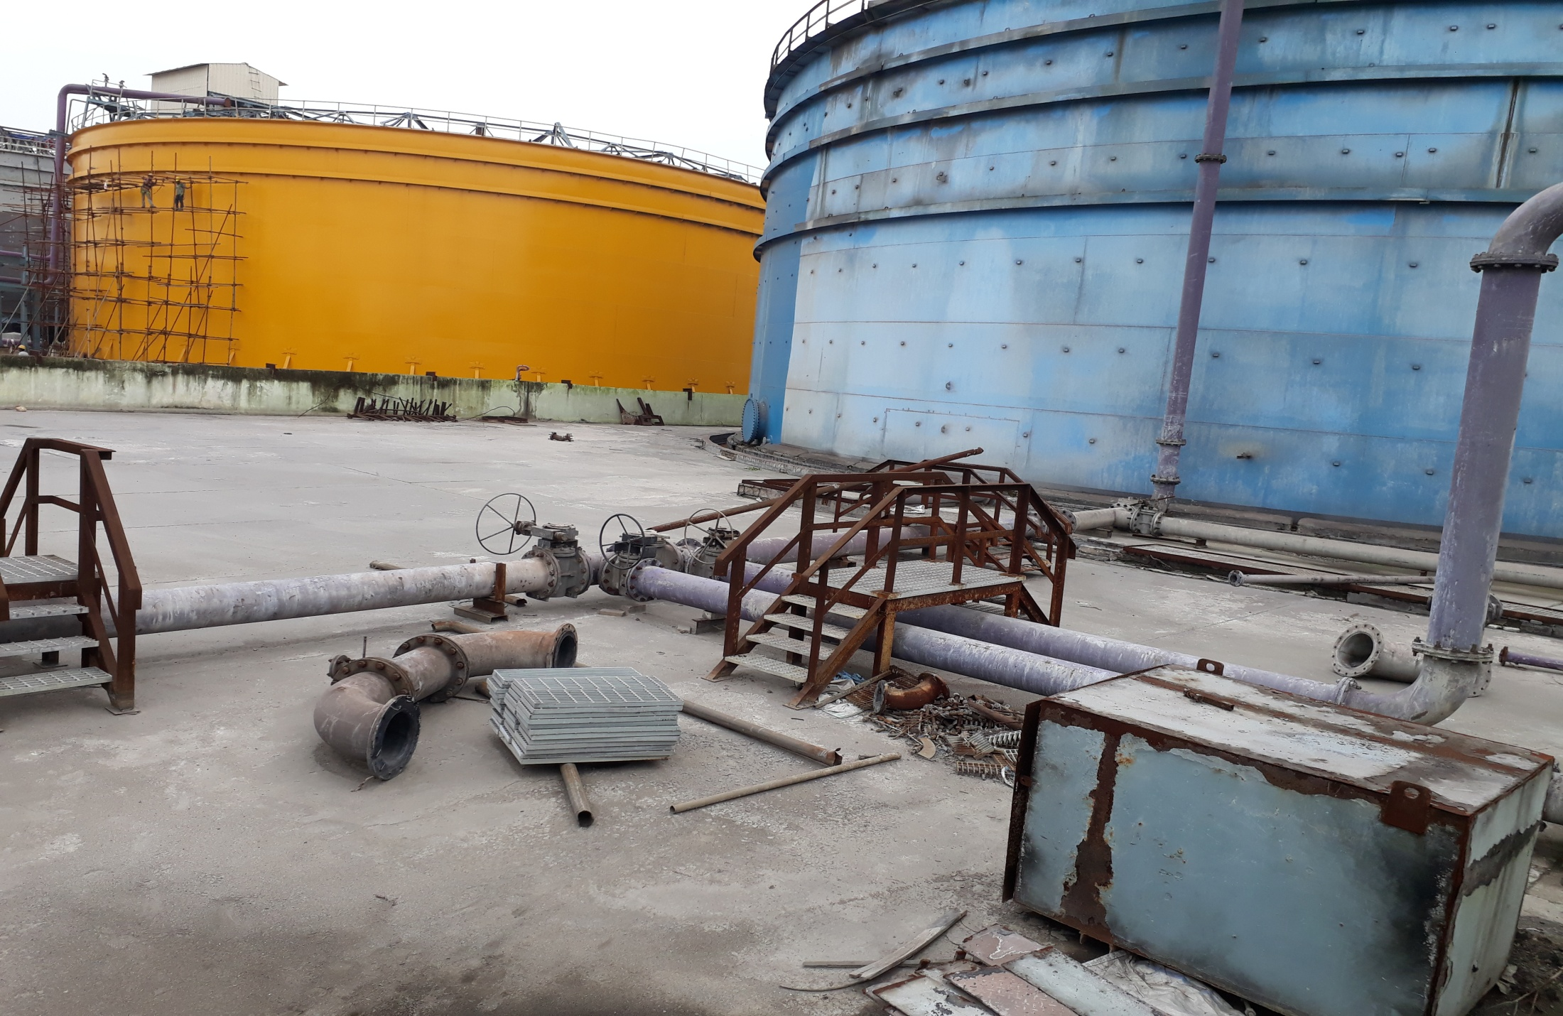
Unwanted Scrap materials are falling at Phosphoric Acid Export tank

Slide 32
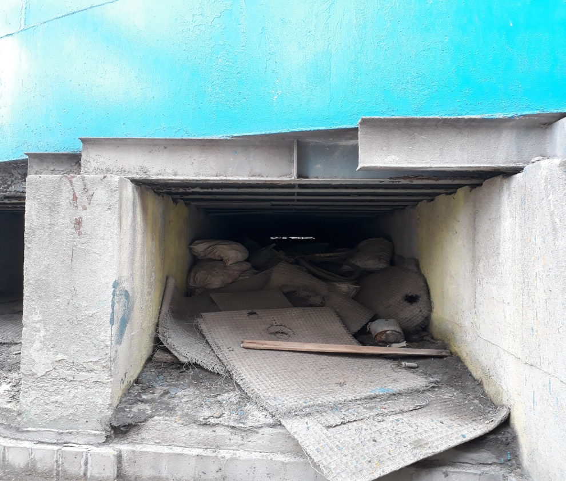
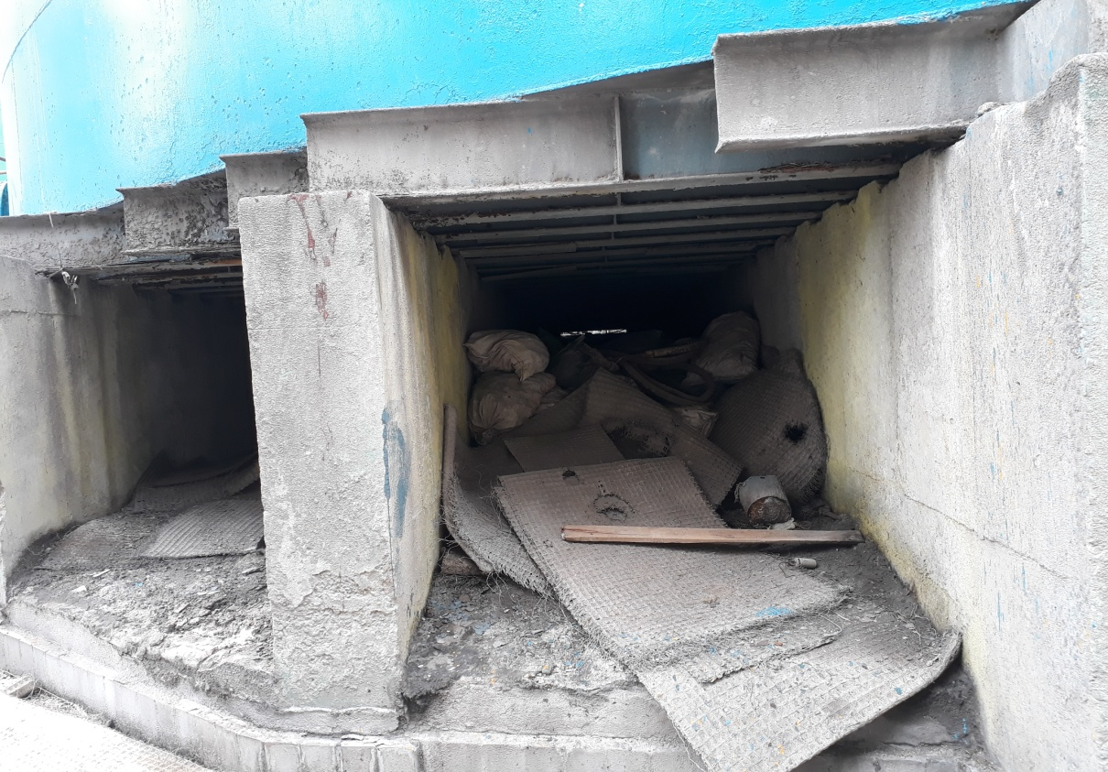
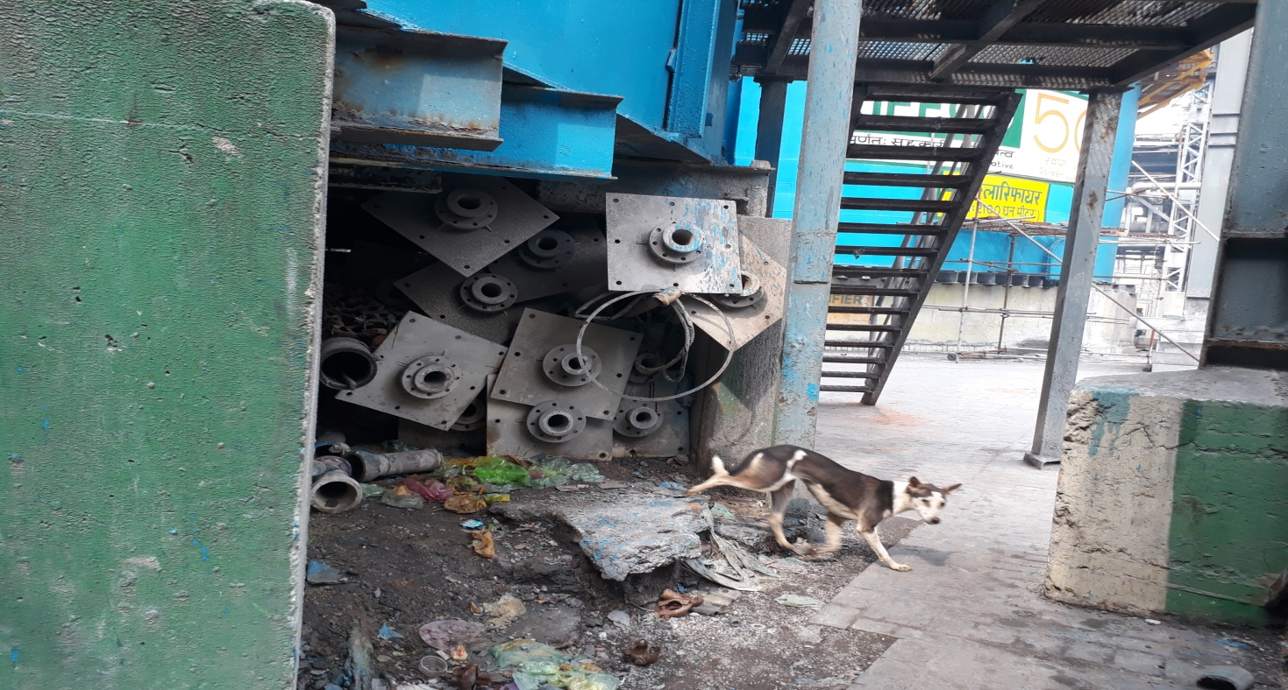
Unwanted
Scrap materials
Are placed at
Phosphoric Acid
Tank Base

Slide 33
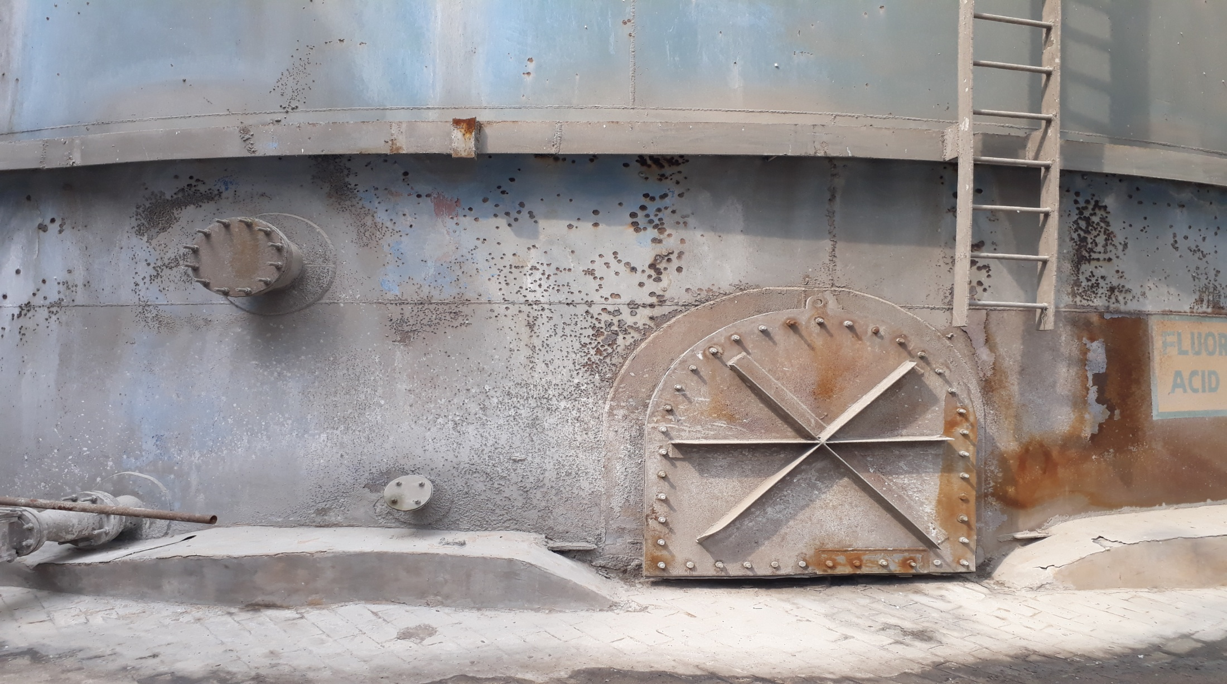
Corrosion and pitting observed at Fluorosilicic Acid Tank

Slide 34
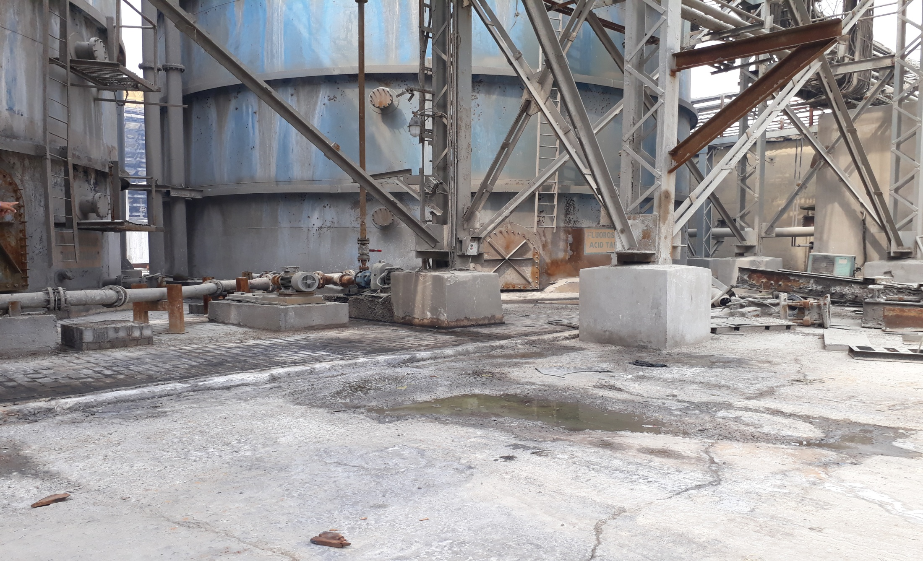
Proper Acid brick lining is required at Flurosilic Acid Tank area

Slide 35
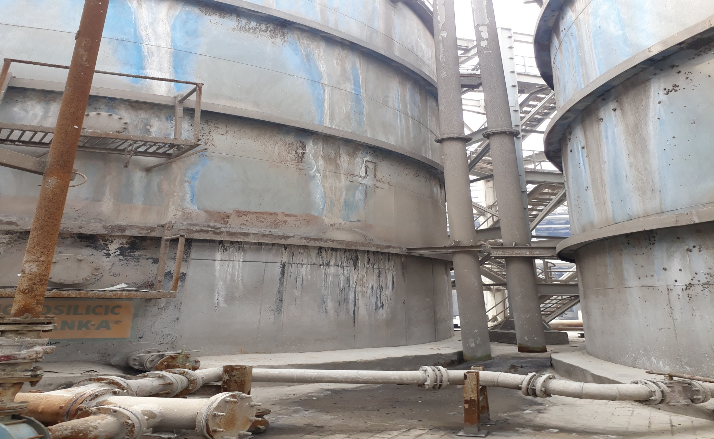
Proper Drainage system is missing for overflow line of Flurosilic Acid tank

Slide 36
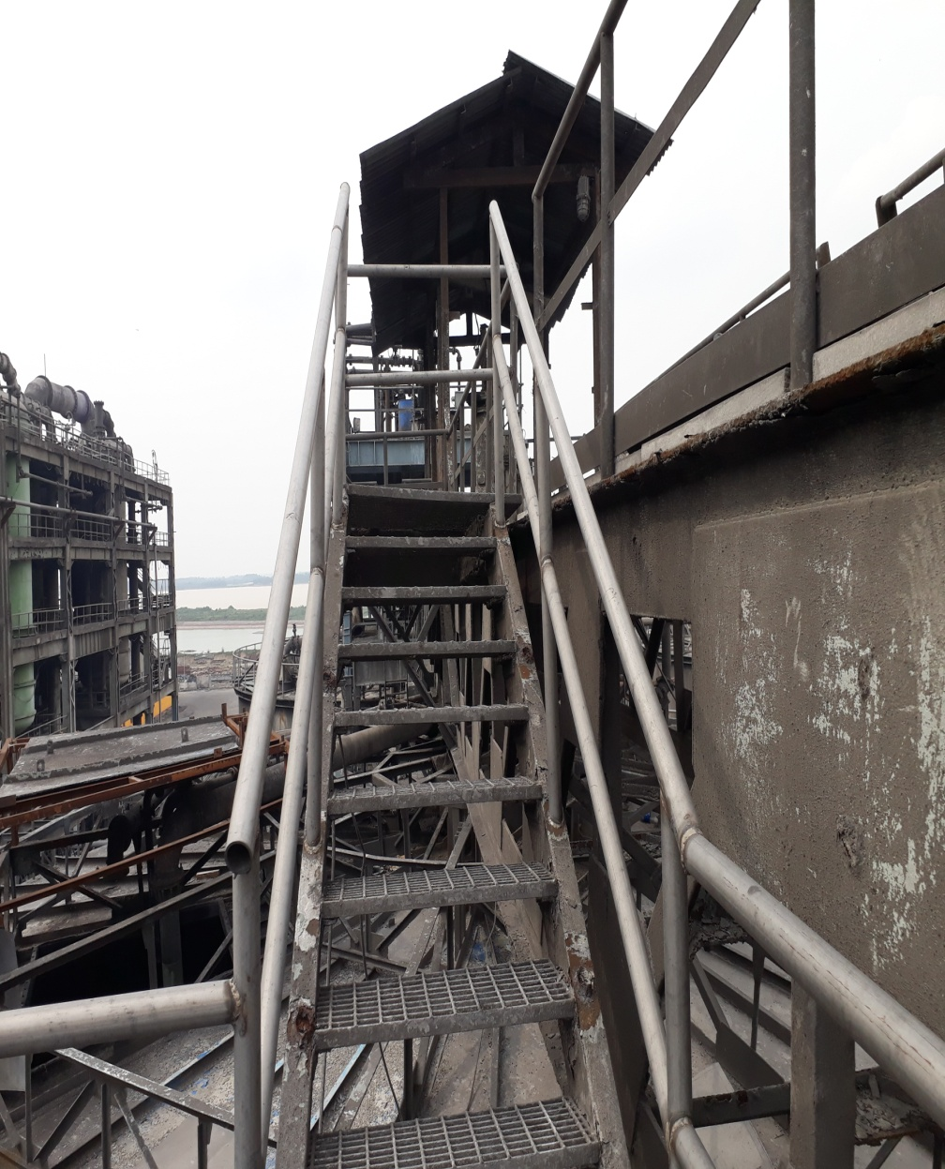
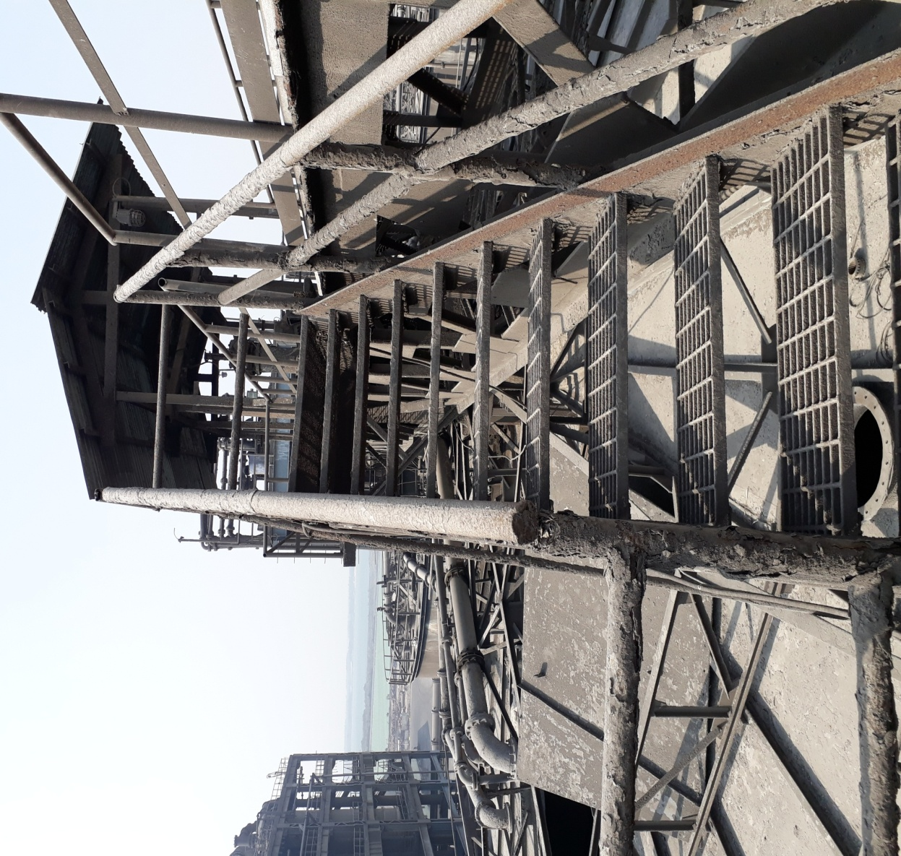
Then
Now
Walkway rail and gratings were badly corroded, the same has been replaced with SS

Slide 37
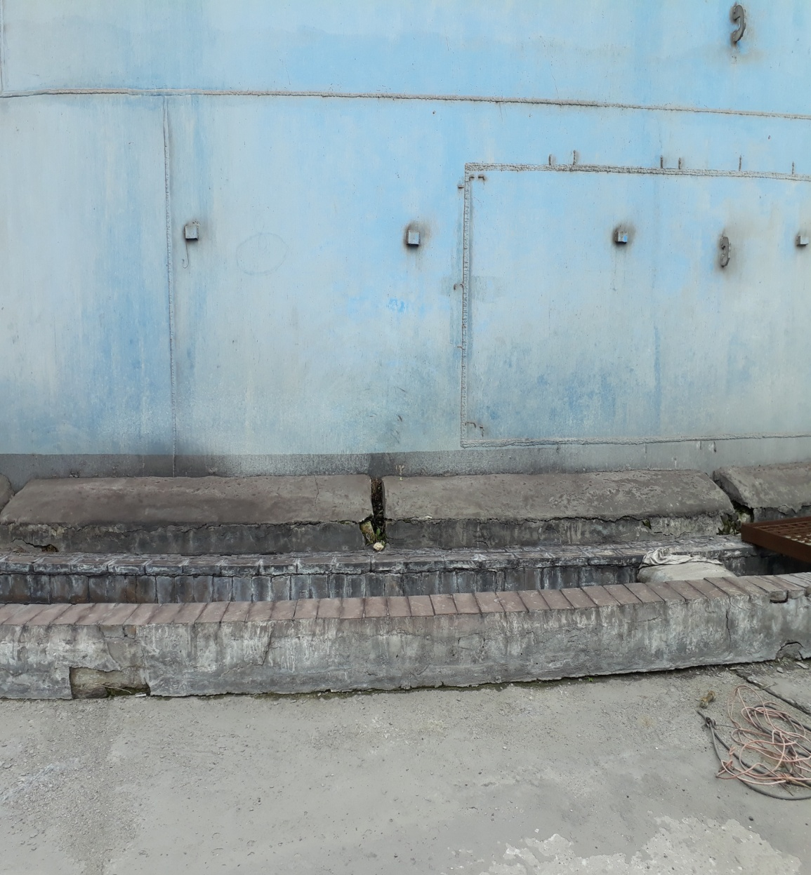
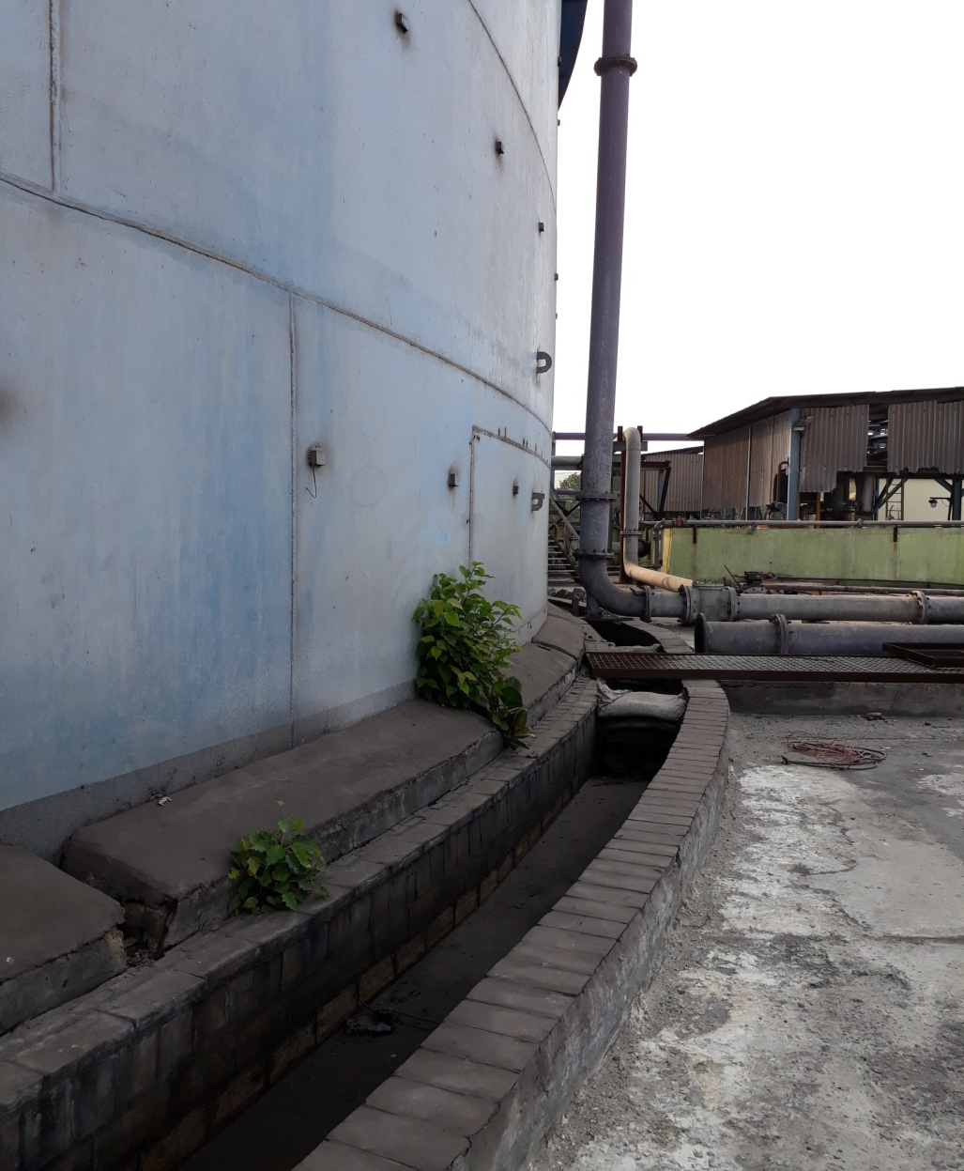
Then
Now
Then Vegetation growth Was observed at Phosphoric Acid Export Tank
Now they are properly removed

Slide 38
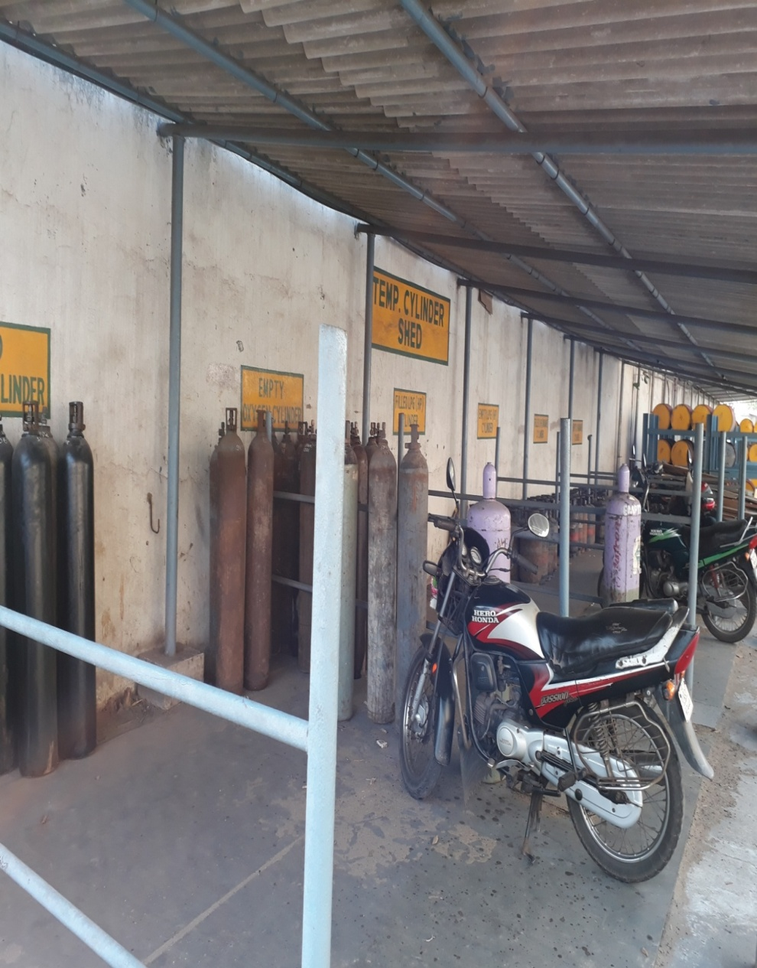
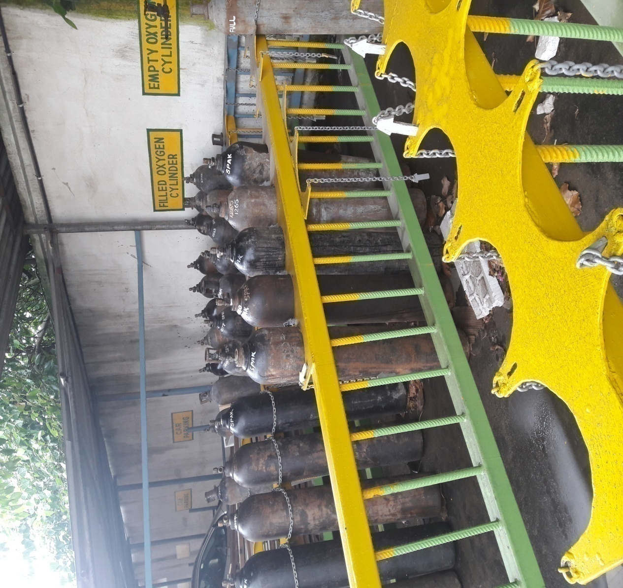
Now
Then
Previously Gas Cylinders are not placed properly, Now it is properly placed and chained.

